Slide 1
HUMAN RESOURCE MANAGEMENT
Dr Vibhav Singh
Session 1 & 2

Slide 2
Course Outline
S.no. | Name of the Module | Tentative No. of sessions
1 | Introduction to HRM | 4
2 | Human Resource System Design | 5
3 | Functional Areas of HRM | 10
4 | HR Planning | 6
5 | SHRM | 4
6 | HRM in Service Sector | 10
7 | Home Assignment | 6

Slide 3





Organization consist of people with formally assigned who work together to achieve organization goals
Manager, person responsible for accomplishing the organization’s goals

Slide 4

What do?
Planning
Organizing
Staffing
Leading
Controlling
1
2
3
4
5

Slide 5
What Managers do?
Planning : Establishing goals and standards, developing rules and procedures; developing plans and forecasting
Organizing: Giving each subordinate a specific tasks, establishing departments; delegating authority to subordinates; coordinating subordinates work
Staffing: Determining what type of people you should hire; training and developing employees, setting performance standards, evaluating performance, compensating employees
Leading: getting others to get job done; maintain morale and motivation
Controlling: Setting standards and checking how actual performance compares to standard

Slide 6
MARKETING
FINANCE AND ACCOUNTING
HUMAN RESOURCES
OPERATIONS
INNOVATION & ENTREPRENURSHIP
IT & ANALYTICS
STRATEGY

Slide 7

What is Human Resource Management?
The process of acquiring, training, appraising, and compensating employees, and of attending to their labor relations, health, safety, and fairness concern.

Slide 8
HR Philosphy
HR philosophy revolves around management’s beliefs and assumption about people their nature, needs, values, and their approach to work. These beliefs and assumptions, then determine how people should be treated. There are three approaches for treating people: commodity approach, machine approach, and humanistic approach. In commodity approach, a person is treated like a commodity who can be bought or sold at a price as was the practice in old slavery system. In machine approach, a person is treated as a part of the machine that can be fitted like any other part. Both these approaches treat a person as physiological human being. In humanistic approach, a person is treated as human being having psychological.

Slide 9
HR Philosphy
Therefore, HR philosophy should take into account all these endowments of human beings more specifically; HR philosophy should be based on the following beliefs: 1. Human beings are the most important assets in the organization. 2. Human beings can be developed to a great extent as they have creative energy which is utilized only partially. 3. Human beings feel committed to their work in the organization if they develop belongingness with it. 4. Human beings are likely to develop a feeling of belongingness if the organization takes care of them and their need satisfaction. 5. Human beings contribute to the maximum if they get an opportunity to discover their full potential and to use it. 6. It is the responsibility of the organization to create healthy and motivating work climate characterized by openness, enthusiasm, trust, mutually, and collaboration

Slide 10
NAME OF THE MODULES | HRM DEFINITION
Planning, Recruitment, & Selection | ACQURING
Performance Management System | APRAISING
Training & Development | TRAINING
Compensation & Benefits | COMPENSATING
Employee Exit & Retention | FAIRNESS & LABOR RELATIONS

Slide 11
HRM FUNCTIONS AND OBJECTIVES
Societal Objectives
SOCIETAL : HRM seeks to ensure that the organization becomes social responsible
ORGANIZATIONAL : To assist organization in attaining its primary goals/objectives
FUNCTIONAL : To maintain contribution at level appropriate to the organization’s need
PERSONAL : To assist employees in achieving their personal goals
Organizational Objectives
Functional Objectives
Personal Objectives

Slide 12
HRM FUNCTIONS AND OBJECTIVES
HRM Objectives | Supporting Functions
Societal Objectives | Legal compliance Benefits Union-Management relationship
Organizational Objectives | Human Resource Planning Employee Relations Training and Development Performance Appraisal Placement
Functional Objectives | Performance Appraisal Placement
Personal Objectives | Compensation Training and Development Performance Appraisal Placement

Slide 13
is HR important ?
NO manager wants to,
Hire wrong person for the job
Experience high turnover
People not performing
Being taken court for wrong reasons

Slide 14
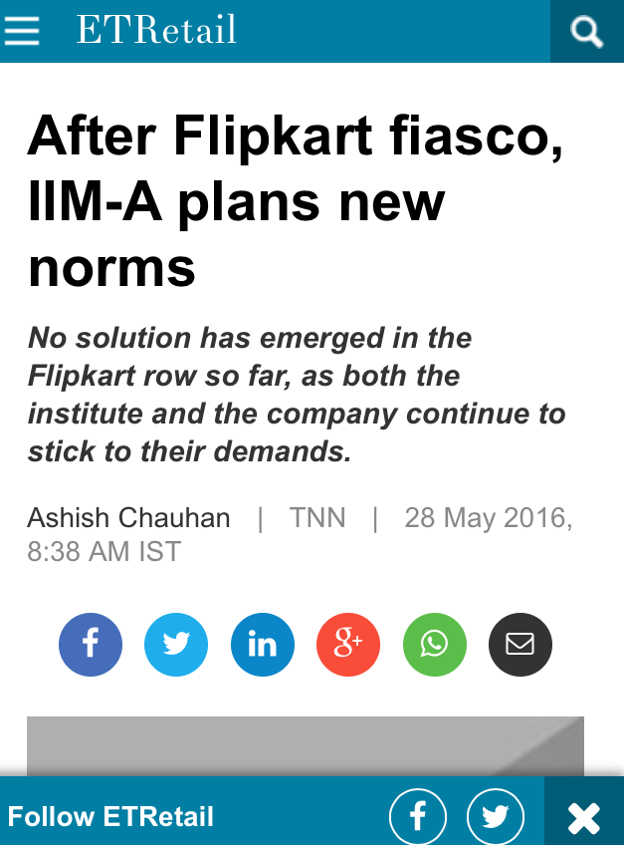
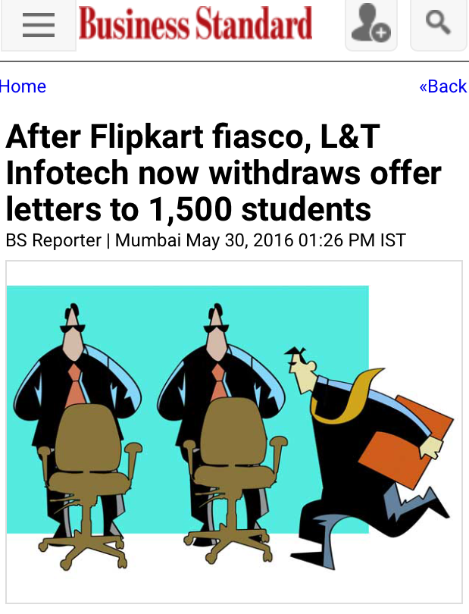

Slide 15

HR GONE WRONG.
MAHINDRA AND MAHINDRA – Firing IT employee by HR

Slide 16

HR GONE RIGHT.
NTPC was the ONLY PSU to feature amongst top 25 companies in the Aon Hewitt Best Employer study.
Competitive selection process
Attracting former employees to join back
Intensive orientation program to groom MT & ET
NTPC offers high quality welfare amenities like healthcare, residential township, and schools for children

Slide 17
Group activity
Based on your personal experiences, list one-two examples reflecting how you used (or could have used) Human Resource Management Techniques at work/school/college/ day-to-day life

Slide 18
Trends shaping HRM
Technology
Dramatically changed how human resource managers do their jobs. Employers can access candidates via Facebook’s job board.
Globalization
Companies extending their sales, ownership, and/or manufacturing to new markets abroad.
Dell assembles PCs in China. Free-trade areas—agreements that reduce tariffs and barriers among trading partners
De-regularization
In many countries, governments stripped away regulations
Establishment of private banks post deregulation

Slide 19
Trends shaping HRM
High-Tech Jobs
“knowledge-intensive high-tech manufacturing in such industries as aerospace, computers, telecommunications, home electronics, pharmaceuticals, and medical instruments” is replacing factory jobs in steel, auto, rubber, and textiles.
Services
Manufacturers are enabling companies to produce more products with fewer employees.
So, in America and much of Europe, manufacturing jobs are down, service jobs up, and the manufacturing jobs that remain are increasingly high-tech.
Knowledge Work and Human Capital
jobs require more education and more skills
Non-Traditional worker
Nontraditional workers are those who hold multiple jobs, or who are “temporary” or part-time workers
Others serve as “independent contractors” on projects.

Slide 20
Trends shaping HRM
Demographic and Workforce Trends, Generation Y and Retirees
The U.S. workforce is also becoming older and more multiethnic. The percentages of younger workers will fall.
The problem is that there aren’t enough younger workers to replace the projected number of baby boom–era older workers retiring.
Generation Y is a double edged sword
Workers from Abroad
The H-1B visa program lets U.S. employers recruit skilled foreign professionals to work in the United States when they can’t find qualified American workers
Economic Challenges and Trends

Slide 21
Trends shaping HRM
Trends
Technological advances
So companies must be
More competitive
HRM needs these competencies
Be strategic
Trends in nature of work
Demographic and workforce trends
Globalization
Economic Challenges
Faster and more responsive
More cost effective
Human capital oriented
More scientific and how do they make decision
New ways to HR services
Adopt talent management to manage human resources
HR metrics
Use evidence based HRM
Understand HR philosophy
Impetus on work ethics

Slide 22
Evolution of HRM

Slide 23
Shift in HRM
1920’s onwards
1960’s onwards
origins of the personnel function can be traced back ,
To the 1920s with the concern for labour welfare in factories
The Trade Union Act of 1926- gave formal recognition to workers’ unions.
Royal Commission on Labour gave rise to the appointment of labour officers in 1932
Factories Act of 1948 laid down the duties and qualifications of labour welfare officers
1960s –
the personnel function began to expand beyond its welfare.
origins with the three areas - labour welfare, industrial relations and personnel administration
1970s-
Thrust of the personnel function shifted towards the need for greater organisational ‘efficiency’ .
1980s-
Personnel professionals began to talk about new concepts such as HRM and HRD
2000s
Strategic and change partner

Slide 24
The ‘new’ HR Manager
Focus more on strategy
Focus on improving performance
Measure HR performance and results
Evidence based HRM
Add ‘Value’
Use new ways to provide HR services
Talent Management Approach
Manage Employee Engagement
Manage Ethics & understand their HR philosophy

Slide 25
The ‘new’ HR Manager
Formulating & executing HR policies and Practices
Produces employee competencies & Behaviors
Aids to achieve its strategic aims
Focus more on Strategy
Assisting organization to address the ‘bigger picture’ issues
Yahoo CEO wanted to improve company’s innovation & Productivity
Eliminated Telecommuting
Adopted new benefits (16 weeks paid maternity leave)

Slide 26
Why are HR policies, procedures and practices important?
They help develop your company culture.
They help employees to understand what is expected of them.
They reflect your business standards.
They provide guidance and tools for managers to assist with the management of employees.
They provide rules surrounding fairness, consistency and clarity.
They ensure you’re meeting your legal obligations in regards to employees.
They help to integrate new staff members and bring them up to speed in the shortest amount of time.

Slide 27
How Do You Effectively Communicate HR Policies and Procedures to Employees?
Make sure the written documentation or guidelines made by the organization are easily understood by all employees to avoid inconsistency and confusion.
Ensures all managers and supervisors are well trained and able to provide training to new employees as well.
Ensure all employees and employers are properly trained in appropriate and inappropriate workplace behavior and work culture norms.
Periodically review the policies and guidelines to ensure they are appropriate and up to date.

Slide 28
Human Resource Management Policies
Employment Policies:
Guideline of the recruitment and selection process of new employees, as well as their orientation.
Employment Status And Records:
Provides access to individual employee accounts, personal files, background checks and performance reviews.
Employee Benefits:
Written terms and conditions defining employee benefits such as paid leave, insurance, holiday and employee reimbursements.

Slide 29
Human Resource Management Policies
Payroll:
Policies related to employee salary and wage, deductions and advances.
Workplace Guidelines:
Guidelines defining work arrangements like conveyance, flex time and use of company assets.
Employee Conduct:
Defining appropriate workplace behaviors and norms, conduct of employees, preventive measures to check substance abuse, harassment and workplace violence.
E- Policies:
These are guides informing employees on proper usage of the organizations information and fair use of the internet.

Slide 30
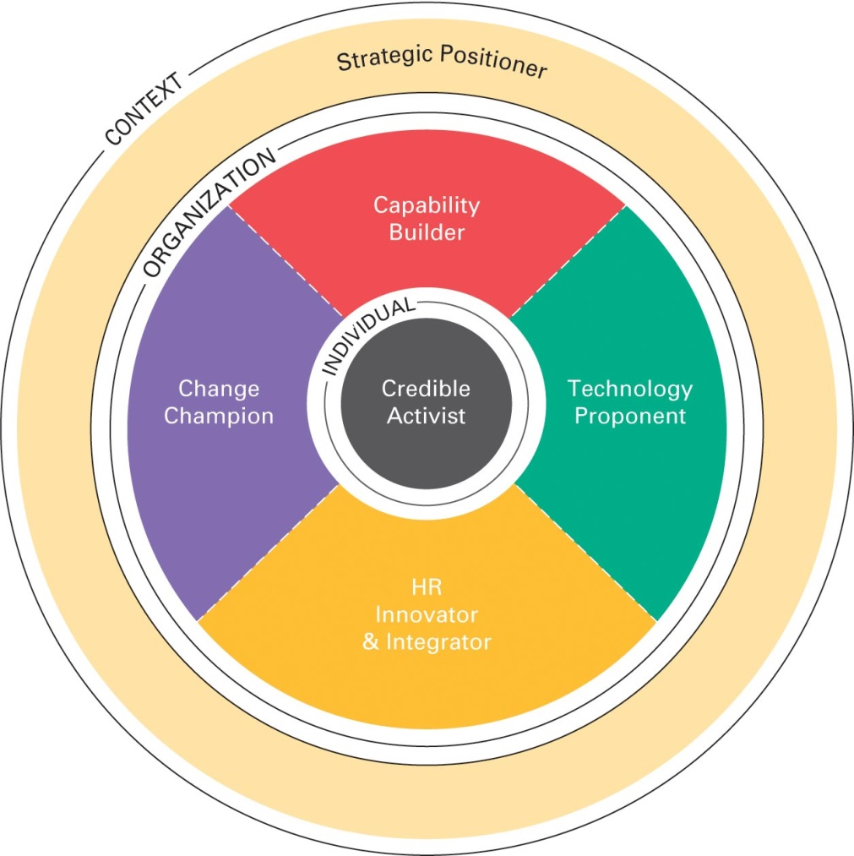
Human Resource Manager’s Competencies
Strategic positioners- helping to create the firm’s strategy.
Credible activists- exhibiting the leadership and other competencies that make them “both credible and active.
Capability builders- creating a meaningful work environment and aligning strategy, culture, practices, and behavior
Change Champions- initiating and sustaining change.
HR innovators and integrators- developing talent, and optimizing human capital through workforce planning and analytics
Technology proponents- connecting people through technology
Notes:
This slide has Figure 1-7 the Human Resource Manager’s competencies.
Strategic positioners—for instance, by helping to create the firm’s strategy.
Credible activists—for instance, by exhibiting the leadership and other competencies that
make them “both credible (respected, admired, listened to) and active (offers a point of view,
takes a position, challenges assumptions).”
Capability builders—for instance, by creating a meaningful work environment and aligning
strategy, culture, practices, and behavior. Capability builders—for instance, by initiating and
sustaining change.
HR innovators and integrators—for instance, by developing talent, and optimizing human
capital through workforce planning and analytics.
Technology proponents—for instance, by connecting people through technology.

Slide 31
HR Challenges
Improving Diversity, Equity And Inclusion (DEI)
Paving The Way For Remote Work
Improving Change Management
Building Critical Skills
Equipping Future Leaders
Finding Talent During A Shortage
Providing Great Employee Experiences
Identifying Skills Employees Will Need Going Forward
Revamping Training Practices
Fostering A Healthy Work Environment

